Slide 1

Kusto Query Language
Petar.Trbos@microsoft.com

Slide 2
What is a scientist after all? It is a curious man looking through a keyhole, the keyhole of nature, trying to know what's going on
- Jacques Yves Cousteau
Notes:
Tutorial: Use Kusto queries in Azure Data Explorer and Azure Monitor | Kusto
Kusto Query Basics - OSG Wiki

Slide 3
Agenda
Introduction to Kusto Query Language
Essential elements
String and DateTime Functions
Parsing Functions
Notes:
Query statement types | Kusto

Slide 4
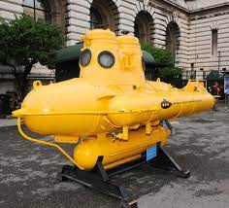
Lesson 1 : Introduction to Kusto Query Language

Slide 5
What is Kusto query
A Kusto query is a read-only request to process data and return results.
The request is stated in plain text, using a data-flow model designed to make the syntax easy to read, author, and automate.
The query uses schema entities that are organized in a hierarchy similar to SQL’s:
databases,
tables,
columns.
Azure Data Explorer was first announced at Ignite 2018:
https://kusto.azurewebsites.net/docs/
https://kusto.azurewebsites.net/docs/kusto/query/index.html
Notes:
KQL stands for Kusto Query Language. It’s the language used to query the Azure log databases: Azure Monitor Logs, Azure Monitor Application Insights and others.
You won't be using Kusto databases for your ERP or CRM, but they’re perfect for massive amounts of streamed data like application logs.
Kusto was the original codename for the Azure Application Insights platform that Azure Monitor is now based on. If you're wondering where the name comes from, it's named after Jacques Cousteau – a French undersea explorer – and you’ll see some cheeky references to Jacques in the Kusto documentation.
Kusto / Azure Data Explorer is a big data analytics cloud service optimized for interactive ad-hoc queries over structured, semi-structured, and unstructured data. Kusto is the internal code name of the project in Microsoft. Externally, the cloud service is called Azure Data Explorer.
The capabilities of Kusto itself are far more extensive than what is currently exposed to external customers via Azure Data Explorer. Over time, these capabilities will be available externally as well (at which time internal users will be migrated to the public offering).
Most of the Kusto team is located in ILDC (Microsoft Israel R&D Center), with representatives in Redmond and San Francisco.
Overview | Kusto

Slide 6
Kusto query usage
KQL is the query language, and the Kusto Engine is the engine that receives the queries in KQL to execute them, and specifically the large datasets from Azure like
Azure Application Insights
Azure Log Analytics
Windows Defender Advanced Threat Protection
Azure Security Center
Apart from these, the data can be ingested from external sources as well.
Notes:
KQL stands for Kusto Query Language. It’s the language used to query the Azure log databases: Azure Monitor Logs, Azure Monitor Application Insights and others.
You won't be using Kusto databases for your ERP or CRM, but they’re perfect for massive amounts of streamed data like application logs.
Kusto was the original codename for the Azure Application Insights platform that Azure Monitor is now based on. If you're wondering where the name comes from, it's named after Jacques Cousteau – a French undersea explorer – and you’ll see some cheeky references to Jacques in the Kusto documentation.
A little bit for everyone , devs, admins, security admins

Slide 7
Anatomy of Kusto query
The query consists of a sequence of query statements, delimited by a semicolon (;),
At least one statement must be tabular expression statement which is a statement that produces data arranged in a table-like mesh of columns and rows.
syntax of the tabular expression statement has tabular data flow from one tabular query operator to another,
starting with data source
flowing through a set of data transformation operators
bound together through the use of the pipe (|) delimiter.
Notes:
Although it looks similar, KQL isn't PowerShell. And it's not the M query language you use in PowerBI either. But that '|' character (called a pipe) is very much the same thing as in PowerShell: it passes (or 'pipes') the data through into the next command.
Using pipes makes it much easier to grasp what’s going on when you read a query, and it helps structure things when you're authoring a query.

Slide 8
Entity types
Kusto queries execute in the context of some Kusto database that is attached to a Kusto cluster. Data in the database is arranged in tables, which the query may reference, and within the table it is organized as a rectangular grid of columns and rows
Entity types are :
Clusters
Tables
Columns
Stored Functions
External Tables
Notes:
Clusters are entities that hold databases. Clusters have no name, but they can be referenced by using the cluster() special function with the cluster's URI. For example, cluster("https://help.kusto.windows.net") is a reference to a cluster that holds the Samples database.
Databases are named entities that hold tables and stored functions. All Kusto queries run in the context of some database, and the entities of that database may be referenced by the query with no qualifications. Additionally, other databases of the cluster, or databases or other clusters, may be referenced using the database() special function. For example, cluster("https://help.kusto.windows.net").database("Samples") is a universal reference to a specific database.
Tables are named entities that hold data. A table has an ordered set of columns, and zero or more rows of data, each row holding one data value for each of the columns of the table. Tables may be referenced by name only if they are in the database in context of the query, or by qualifying them with a database reference otherwise. For example, cluster("https://help.kusto.windows.net").database("Samples").StormEvents is a universal reference to a particular table in the Samples database. Tables may also be referenced by using the table() special function.
Columns are named entities that have a scalar data type. Columns are referenced in the query relative to the tabular data stream that is in context of the specific operator referencing them.
Stored functions are named entities that allow reuse of Kusto queries or query parts.
External tables are entities that reference data stored outside Kusto database. External tables are used for exporting data from Kusto to external storage as well as for querying external data without ingesting it into Kusto.

Slide 9
Entity names
Entity names are case-sensitive for resolving purposes (so, for example, you can't refer to a table called ThisTable as thisTABLE) and is guaranteed to be unique in the scope of its container given its type
Naming rules :
They have between 1 and 1024 characters long.
They may contain letters, digits, underscores (_), spaces, dots (.), and dashes (-).
Identifiers consisting only of letters, digits, and underscores do not require quoting when the identifier is being referenced.
Identifiers containing at last one of (spaces, dots, or dashes) do require quoting.
They are case-sensitive.
StormEvents //no special chars
[‘Storm-Events’] //special chars must use [] and ‘’ or “”
[“where”] //language keywords must use [] and ‘’ or “”
Notes:
Kusto entities (databases, tables, columns, and stored functions; clusters are an exception) are named. The name of an entity identifies the entity, and is guaranteed to be unique in the scope of its container given its type. (So, for example, two tables in the same database can't have the same name, but a table and a database may have the same name because they are not in the same scope, and a table and a stored function may have the same name because they are not of the same entity type.)

Slide 10
Kusto data types
Type | Additional name(s) | Equivalent .NET type | gettype()
bool | boolean | System.Boolean | int8
datetime | date | System.DateTime | datetime
dynamic |  | System.Object | array or dictionary or any of the other values
guid |  | System.Guid | guid
int |  | System.Int32 | int
long |  | System.Int64 | long
real | double | System.Double | real
string |  | System.String | string
timespan | time | System.TimeSpan | timespan
decimal |  | System.Data.SqlTypes.SqlDecimal | decimal
Notes:
All non-string data types include a special "null" value, which represents the lack of data or a mismatch of data. For example, attempting to ingest the string "abc" into an int column results in this value. It isn't possible to materialize this value explicitly, but you can detect whether an expression evaluates to this value by using the isnull() function..
Unsupported types are :
System.Single (float)
System.Int16
System.UInt16
System.UInt32
System.UInt64
System.Byte

Slide 11
Dynamic type
The dynamic scalar data type is special in that it can take on any value of other scalar data types from the list below, as well as arrays and property bags. Specifically, a dynamic value can be:
Null.
A value of any of the primitive scalar data types: bool, datetime, guid, int, long, real, string, and timespan.
An array of dynamic values, holding zero or more values with zero-based indexing.
A property bag that maps unique string values to dynamic values. The property bag has zero or more such mappings (called "slots"), indexed by the unique string values. The slots are unordered.
Notes:
Kusto entities (databases, tables, columns, and stored functions; clusters are an exception) are named. The name of an entity identifies the entity, and is guaranteed to be unique in the scope of its container given its type. (So, for example, two tables in the same database can't have the same name, but a table and a database may have the same name because they are not in the same scope, and a table and a stored function may have the same name because they are not of the same entity type.)

Slide 12
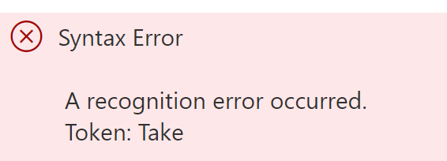
Anatomy of Kusto query
KQL commands are case-sensitive but the operators could be both sensitive and insensitive
Comments are noted with //
StormEvents //let's list 10 sampling rows
| take 10
StormEvents //same query taking wrong command name
| Take 10

Slide 13
Anatomy of Kusto query
StormEvents
| where StartTime >= datetime(2007-11-01) and StartTime < datetime(2007-12-01)
| where State == "FLORIDA"
| count // inline comment

Slide 14
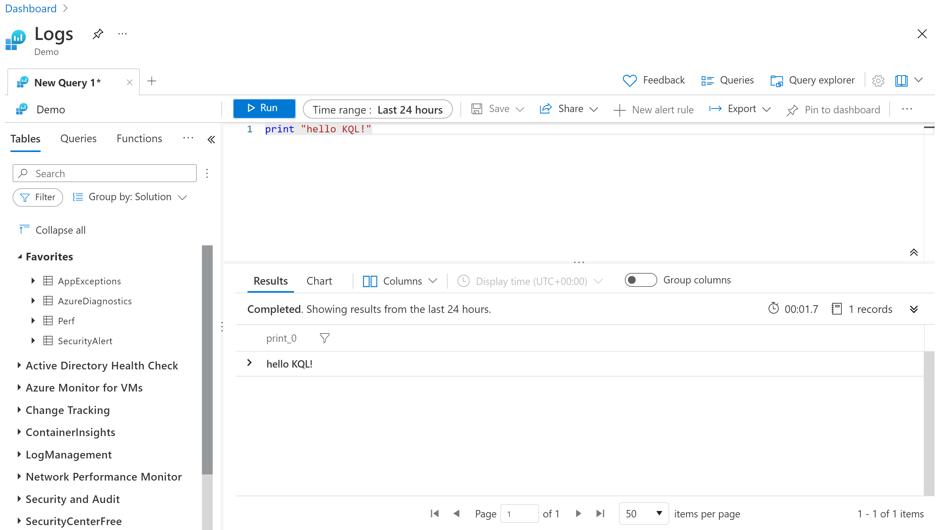
Playground
https://aka.ms/LADemo
https://ms.portal.azure.com/#blade/Microsoft_Azure_Monitoring_Logs/DemoLogsBlade
Notes:
Also Azure Data Explorer
PowerBI
StormEvents
| sort by DamageCrops desc
| take 1000

Slide 15

Demo 01 : Anatomy of Kusto Query
Notes:
Use net sites:
https://aka.ms/LADemo
https://dataexplorer.azure.com/clusters/help

Slide 16
Lesson 2 : Essential elements

Slide 17
Count rows
StormEvents
| count
StormEvents
| where StartTime >= datetime(2007-11-01) and StartTime < datetime(2007-12-01)
| where State == "FLORIDA"
| count // inline comment

Slide 18
Show n rows: take operator
Let's see some data. What's in a random sample of five rows?
There is no guarantee which records are returned,
Use project to pick out only the columns you want.
Take and limit are synonyms
StormEvents
| take 5
StormEvents
| take 5
| project StartTime, EndTime , State , EventType , EpisodeNarrative

Slide 19
Show distinct values: distinct operator
Produces a table with the distinct combination of the provided columns of the input table.
StormEvents
| distinct State
StormEvents
| where StartTime > datetime(2007-02-01) and StartTime < datetime(2007-03-01)
| distinct State , EventType , EpisodeNarrative

Slide 20
Select a subset of columns: project
Use project to pick out only the columns you want.
StormEvents
| where StartTime > datetime(2007-02-01) and StartTime < datetime(2007-03-01)
| where EventType == 'Flood' and State == 'CALIFORNIA’
| project StartTime, EndTime , State , EventType , EpisodeNarrative

Slide 21
Select a subset of columns: project
Use project to pick out only the columns you want.
T
| project
X=C, // Rename column C to X
A=2*B, // Calculate a new column A from the old B
C=strcat("-",tostring(C)), // Calculate a new column C from the old C
B=2*B // Calculate a new column B from the old B

Slide 22
Order results: sort, top
Show me the first n rows, ordered by a specific column:
StormEvents
| top 5 by StartTime desc
| project StartTime, EndTime, EventType, State, EventNarrative
StormEvents
| sort by StartTime desc
| take 5
| project StartTime, EndTime, EventType, State, EventNarrative

Slide 23
Compute derived columns: extend
Create a new column by computing a value in every row:
StormEvents
| limit 5
| extend Duration = EndTime - StartTime
| project StartTime, EndTime, Duration, EventType, State

Slide 24
Aggregate groups of rows: summarize
summarize groups together rows that have the same values in the by clause, and then uses an aggregation function (for example, count) to combine each group in a single row.
StormEvents
| summarize event_count = count() by State
StormEvents
| summarize StormCount = count(), TypeOfStorms = dcount(EventType) by State
| top 5 by StormCount desc

Slide 25
Summarize: list of aggregate functions
any() | dcountif() | percentiles_array()
anyif() | make_bag() | percentilesw()
arg_max() | make_bag_if() | percentilesw_array()
arg_min() | make_list() | stdev()
avg() | make_list_if() | stdevif()
avgif() | make_list_with_nulls() | sum()
binary_all_and | make_set() | sumif()
binary_all_or | make_set_if() | variance()
binary_all_xor | max() | varianceif()
buildschema() | maxif()
count() | min()
countif() | minif()
dcount() | percentiles()

Slide 26
Function | Description
any() | Returns a random non-empty value for the group
anyif() | Returns a random non-empty value for the group (with predicate)
arg_max() | Returns one or more expressions when the argument is maximized
arg_min() | Returns one or more expressions when the argument is minimized
avg() | Returns an average value across the group
avgif() | Returns an average value across the group (with predicate)
binary_all_and | Returns aggregated value using the binary AND of the group
binary_all_or | Returns aggregated value using the binary OR of the group
binary_all_xor | Returns aggregated value using the binary XOR of the group
buildschema() | Returns the minimal schema that admits all values of the dynamic input
count() | Returns a count of the group
countif() | Returns a count with the predicate of the group
dcount() | Returns an approximate distinct count of the group elements
dcountif() | Returns an approximate distinct count of the group elements (with predicate)
make_bag() | Returns a property bag of dynamic values within the group
make_bag_if() | Returns a property bag of dynamic values within the group (with predicate)
make_list() | Returns a list of all the values within the group
make_list_if() | Returns a list of all the values within the group (with predicate)
make_list_with_nulls() | Returns a list of all the values within the group, including null values
make_set() | Returns a set of distinct values within the group
make_set_if() | Returns a set of distinct values within the group (with predicate)
max() | Returns the maximum value across the group
maxif() | Returns the maximum value across the group (with predicate)
min() | Returns the minimum value across the group
minif() | Returns the minimum value across the group (with predicate)
percentiles() | Returns the percentile approximate of the group
percentiles_array() | Returns the percentiles approximates of the group
percentilesw() | Returns the weighted percentile approximate of the group
percentilesw_array() | Returns the weighted percentiles approximates of the group
stdev() | Returns the standard deviation across the group
stdevif() | Returns the standard deviation across the group (with predicate)
sum() | Returns the sum of the elements within the group
sumif() | Returns the sum of the elements within the group (with predicate)
variance() | Returns the variance across the group
varianceif() | Returns the variance across the group (with predicate)

Slide 27
Summarize by scalar values
You can use scalar (numeric, time, or interval) values in the by clause, but you'll want to put the values into bins by using the bin() function:
bin() function simply reduces every value to the nearest multiple of the modulus that you supply, so that summarize can assign the rows to groups.
StormEvents
| where StartTime > datetime(2007-02-14) and StartTime < datetime(2007-02-21)
| summarize event_count = count() by bin(StartTime, 1d)

Slide 28
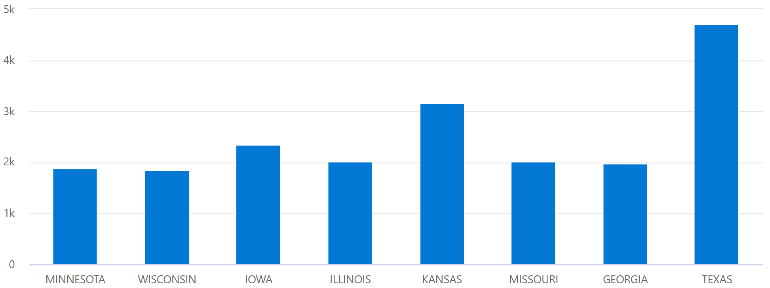
Display a chart or table: render
You can project two columns and use them as the x-axis and the y-axis of a chart:
StormEvents
| summarize event_count=count(), mid = avg(BeginLat) by State
| sort by mid
| where event_count > 1800
| project State, event_count
| render columnchart

Slide 29
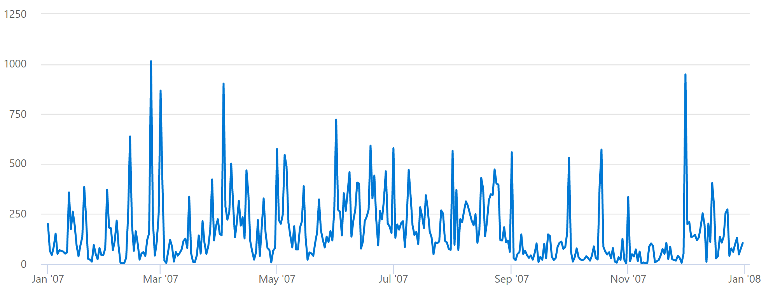
Display a chart or table: Timecharts
You can project two columns and use them as the x-axis and the y-axis of a chart:
StormEvents
| summarize event_count=count() by bin(StartTime, 1d)
| render timechart

Slide 30
render visualizations
anomalychart | piechart
areachart | pivotchart
barchart | scatterchart
card | stackedareachart
columnchart | table
ladderchart | timechart
linechart | timepivot

Slide 31
Demo 02 : Operators
Notes:
Logs - Microsoft Azure

Slide 32
Lesson 3 : Functions

Slide 33
KQL Functions
Functions are reusable queries or query parts.
Kusto supports several kinds of functions:
Stored functions,
which are user-defined functions that are stored and managed a one kind of a database's schema entities. See Stored functions.
Query-defined functions
which are user-defined functions that are defined and used within the scope of a single query. The definition of such functions is done through a let statement. See User-defined functions.
Built-in functions
which are hard-coded (defined by Kusto and cannot be modified by users).

Slide 34
Built-in KQL Functions
Functions are reusable queries or query parts.
Kusto supports several kinds of functions:
Scalar functions,
A scalar function is a function whose result or output is a scalar quantity.
Aggregation functions
is a function where the values of multiple rows are grouped together to form a single summary value.
Window functions
Window functions operate on multiple rows (records) in a row set at a time. Unlike aggregation functions, window functions require that the rows in the row set be serialized (have a specific order to them). Window functions may depend on the order to determine the result.
Special Functions

Slide 35
Scalar KQL Functions
Binary functions | Conditional functions
Conversion functions | Series element-wise functions
DateTime/timespan functions | Series processing functions
Dynamic/array functions | String functions
Window scalar functions | IPv4/IPv6 functions
Flow control functions | Type functions
Mathematical functions | Scalar aggregation functions
Metadata functions | Geospatial functions
Rounding functions | Hash functions

Slide 36
String Functions
base64_encode_tostring() | parse_csv() | strcat_delim()
base64_decode_tostring() | parse_ipv4() | strcmp()
base64_decode_toarray() | parse_ipv4_mask() | strlen()
countof() | parse_ipv6() | strrep()
extract() | parse_ipv6_mask() | substring()
extract_all() | parse_json() | toupper()
extractjson() | parse_url() | translate()
indexof() | parse_urlquery() | trim()
isempty() | parse_version() | trim_end()
isnotempty() | replace() | trim_start()
isnotnull() | reverse() | url_decode()
isnull() | split() | url_encode()
parse_command_line() | strcat()

Slide 37
Lesson 4 : Parsing functions

Slide 38
split operator
Splits a given string according to a given delimiter and returns a string array with the contained substrings.
Optionally, a specific substring can be returned if exists
print split("aa_bb", "_"), // ["aa","bb"]
split("aaa_bbb_ccc", "_", 1), // ["bbb"]
split("", "_"), // [""]
split("a__b", "_"), // ["a","","b"]
split("aabbcc", "bb") // ["aa","cc"]

Slide 39
parse operator
Evaluates a string expression and parses its value into one or more calculated columns. The calculated columns will have nulls, for unsuccessfully parsed strings
AppExceptions
| parse Assembly with *
"Version=" _version
"Culture=" _myCulture
"PublicKeyToken" _myPKT
| project Assembly, _version, _myCulture, _myPKT
| top 10 by _version desc

Slide 40
parse arguments
T | parse [kind=regex [flags=regex_flags] |simple|relaxed] Expression with *
Kind
Simple (default)
Regex
Flags
relaxed
Expression
ColumnName
ColumnType
Notes:
simple (the default): StringConstant is a regular string value and the match is strict. All string delimiters should appear in the parsed string, and all extended columns must match the required types.
regex: StringConstant may be a regular expression and the match is strict. All string delimiters, which can be a regex for this mode, should appear in the parsed string, and all extended columns must match the required types.
flags: Flags to be used in regex mode like U (Ungreedy), m (multi-line mode), s (match new line \n), i (case-insensitive) in RE2 flags.
relaxed: StringConstant is a regular string value and the match is relaxed. All string delimiters should appear in the parsed string, but extended columns may partially match the required types.

Slide 41
todynamic and parse_json operator
Interprets a string as a JSON value and returns the value as dynamic.
let d='{"a":123, "b":"{\\"c\\":456}"}'; print d_b_c=parse_json(tostring(parse_json(d).b)).c
Notes:
This function is better than extractjson() function when you need to extract more than one element of a JSON compound object. Prefer using dynamic() when possible.

Slide 42
Parse_csv operator
Splits a given string representing a single record of comma-separated values and returns a string array with these values.
print result=parse_csv('aa,"b,b,b",cc,"Escaping quotes: ""Title""","line1\nline2"')
Notes:
Returns
A string array that contains the split values.
Notes
Embedded line feeds, commas, and quotes may be escaped using the double quotation mark ('"'). This function doesn't support multiple records per row (only the first record is taken).

Slide 43
Demo 03 : Parsing
Notes:
Logs - Microsoft Azure

Slide 44
DATETIME/TIMESPAN Functions
ago() | format_datetime() | startofweek()
datetime_add() | format_timespan() | startofyear()
datetime_part() | getmonth() | todatetime()
datetime_diff() | getyear() | totimespan()
dayofmonth() | hourofday() | unixtime_microseconds_todatetime()
dayofweek() | make_datetime() | unixtime_milliseconds_todatetime()
dayofyear() | make_timespan() | unixtime_nanoseconds_todatetime()
endofday() | monthofyear() | unixtime_seconds_todatetime()
endofmonth() | now() | weekofyear()
endofweek() | startofday()
endofyear() | startofmonth()

Slide 45
Demo 04 : String and DateTime functions
Notes:
Logs - Microsoft Azure

Slide 46
Conditional Functions
case()
coalesce()
iif()/iff()
max_of()
min_of()

Slide 47
Conversion Functions
tobool()
todatetime()
todouble()/toreal()
tostring()
totimespan()

Slide 48
Metadata Functions
column_ifexists()
current_cluster_endpoint()
current_database()
current_principal()
current_principal_details()
current_principal_is_member_of()
cursor_after()
estimate_data_size()
extent_id()
extent_tags()
ingestion_time()

Slide 49
Window Scalar Functions
next()
prev()
row_cumsum()
row_number()
row_rank()

Slide 50
Demo 05 : String and DateTime functions
Notes:
Logs - Microsoft Azure

Slide 51
Mathematical Functions
abs() | exp10() | pow()
acos() | exp2() | radians()
asin() | gamma() | rand()
atan() | isfinite() | range()
atan2() | isinf() | round()
beta_cdf() | isnan() | sign()
beta_inv() | log() | sin()
beta_pdf() | log10() | sqrt()
cos() | log2() | tan()
cot() | loggamma() | welch_test()
degrees() | not()
exp() | pi()

Slide 52
Mathematical Functions
abs() | exp10() | pow()
acos() | exp2() | radians()
asin() | gamma() | rand()
atan() | isfinite() | range()
atan2() | isinf() | round()
beta_cdf() | isnan() | sign()
beta_inv() | log() | sin()
beta_pdf() | log10() | sqrt()
cos() | log2() | tan()
cot() | loggamma() | welch_test()
degrees() | not()
exp() | pi()

Slide 53
Lesson 5 : Datasets

Slide 54
Datatable
Returns a table whose schema and values are defined in the query itself
datatable (Date:datetime, Event:string)
[datetime(1910-06-11), "Born",
datetime(1930-01-01), "Enters Ecole Navale",
datetime(1953-01-01), "Published first book",
datetime(1997-06-25), "Died"]
| where strlen(Event) > 4

Slide 55
Join operator
Merge the rows of two tables to form a new table by matching values of the specified columns from each table
let Events = MyLogTable | where type=="Event" ;
Events
| where Name == "Start"
| project Name, City, ActivityId, StartTime=timestamp
| join (Events
| where Name == "Stop"
| project StopTime=timestamp, ActivityId)
on ActivityId
| project City, ActivityId, StartTime, StopTime, Duration = StopTime - StartTime

Slide 56
Join types
Join kind/flavor | Description
innerunique (or empty as default) | Inner join with left side deduplication
inner | Standard inner join
leftouter | Left outer join
rightouter | Right outer join
fullouter | Full outer join
leftanti, anti, or leftantisemi | Left anti join
rightanti or rightantisemi | Right anti join
leftsemi | Left semi join
rightsemi | Right semi join

Slide 57
Union operator
Takes two or more tables and returns the rows of all of them.
(SecurityAlert
| where ProviderName =="MDATP")
| union
(SecurityAlert
| where ProviderName =="MSTIC")
Notes:
Arguments
Table:
The name of a table, such as Events; or
A query expression that must be enclosed with parenthesis, such as (Events | where id==42) or (cluster("https://help.kusto.windows.net:443").database("Samples").table("*")); or
A set of tables specified with a wildcard. For example, E* would form the union of all the tables in the database whose names begin E.
kind:
inner - The result has the subset of columns that are common to all of the input tables.
outer - (default). The result has all the columns that occur in any of the inputs. Cells that weren't defined by an input row are set to null.
withsource=ColumnName: If specified, the output will include a column called ColumnName whose value indicates which source table has contributed each row. If the query effectively (after wildcard matching) references tables from more than one database (default database always counts) the value of this column will have a table name qualified with the database. Similarly cluster and database qualifications will be present in the value if more than one cluster is referenced.
isfuzzy= true | false: If isfuzzy is set to true - allows fuzzy resolution of union legs. Fuzzy applies to the set of union sources. It means that while analyzing the query and preparing for execution, the set of union sources is reduced to the set of table references that exist and are accessible at the time. If at least one such table was found, any resolution failure will yield a warning in the query status results (one for each missing reference), but will not prevent the query execution; if no resolutions were successful - the query will return an error. The default is isfuzzy= false.

Slide 58
Let statement
Let statements bind names to expressions. For the rest of the scope, where the let statement appears, the name can be used to refer to its bound value.
The let statement may be within a global scope or a function body scope.
Let statements improve modularity and reuse, since they let you break a potentially complex expression into multiple parts.
let statements can be:
Scalar types
Tabular types
User-defined functions (lambdas)
let start_time = ago(5h);
let end_time = start_time + 2h;
Notes:
Arguments
Table:
The name of a table, such as Events; or
A query expression that must be enclosed with parenthesis, such as (Events | where id==42) or (cluster("https://help.kusto.windows.net:443").database("Samples").table("*")); or
A set of tables specified with a wildcard. For example, E* would form the union of all the tables in the database whose names begin E.
kind:
inner - The result has the subset of columns that are common to all of the input tables.
outer - (default). The result has all the columns that occur in any of the inputs. Cells that weren't defined by an input row are set to null.
withsource=ColumnName: If specified, the output will include a column called ColumnName whose value indicates which source table has contributed each row. If the query effectively (after wildcard matching) references tables from more than one database (default database always counts) the value of this column will have a table name qualified with the database. Similarly cluster and database qualifications will be present in the value if more than one cluster is referenced.
isfuzzy= true | false: If isfuzzy is set to true - allows fuzzy resolution of union legs. Fuzzy applies to the set of union sources. It means that while analyzing the query and preparing for execution, the set of union sources is reduced to the set of table references that exist and are accessible at the time. If at least one such table was found, any resolution failure will yield a warning in the query status results (one for each missing reference), but will not prevent the query execution; if no resolutions were successful - the query will return an error. The default is isfuzzy= false.

Slide 59
Demo 06 : Datatable
Notes:
Logs - Microsoft Azure

Slide 60
Lesson 9 : Advanced functions

Slide 61
Pivot statement
Rotates a table by turning the unique values from one column in the input table into multiple columns in the output table, and performs aggregations where they are required on any remaining column values that are wanted in the final output.
StormEvents
| project State, EventType
| where State startswith "AL"
| where EventType has "Wind"
| evaluate pivot(State)
Notes:
Arguments
pivotColumn: The column to rotate. each unique value from this column will be a column in the output table.
aggregation function: (optional) aggregates multiple rows in the input table to a single row in the output table. Currently supported functions: min(), max(), any(), sum(), dcount(), avg(), stdev(), variance(), make_list(), make_bag(), make_set(), count() (default is count()).
column1, column2, ...: (optional) column names. The output table will contain an additional column per each specified column. default: all columns other than the pivoted column and the aggregation column.

Slide 62
Basket statement
Basket finds all frequent patterns of discrete attributes (dimensions) in the data.
It then returns the frequent patterns that passed the frequency threshold in the original query.
Basket is based on the Apriori algorithm originally developed for basket analysis data mining.
StormEvents
| where monthofyear(StartTime) == 5
| extend Damage = iff(DamageCrops + DamageProperty > 0 , "YES" , "NO")
| project State, EventType, Damage, DamageCrops
| evaluate basket(0.2);
Notes:
Basket is guaranteed to find every frequent pattern in the data, but isn't guaranteed to have polynomial runtime. The runtime of the query is linear in the number of rows, but it might be exponential in the number of columns (dimensions).
Arguments (all optional)
T | evaluate basket([Threshold, WeightColumn, MaxDimensions, CustomWildcard, CustomWildcard, ...])
All arguments are optional, but they must be ordered as above. To indicate that the default value should be used, use the string tilde value - '~'. See examples below.
Available arguments:
Threshold - 0.015 < double < 1 [default: 0.05]
Sets the minimal ratio of the rows to be considered frequent. Patterns with a smaller ratio won't be returned.
Example: T | evaluate basket(0.02)
WeightColumn - column_name
Considers each row in the input according to the specified weight. By default, each row has a weight of '1'. The argument must be a name of a numeric column, such as int, long, real. A common use of a weight column, is to take into account sampling or bucketing/aggregation of the data that is already embedded into each row.
Example: T | evaluate basket('~', sample_Count)
MaxDimensions - 1 < int [default: 5]
Sets the maximal number of uncorrelated dimensions per basket, limited by default, to minimize the query runtime.
Example: T | evaluate basket('~', '~', 3)
CustomWildcard - "any_value_per_type"
Sets the wildcard value for a specific type in the result table that will indicate that the current pattern doesn't have a restriction on this column. Default is null. The default for a string is an empty string. If the default is a good value in the data, a different wildcard value should be used, such as *.

Slide 63
Autocluster statement
autocluster finds common patterns of discrete attributes (dimensions) in the data. It then reduces the results of the original query, whether it's 100 or 100k rows, to a small number of patterns. The plugin was developed to help analyze failures (such as exceptions or crashes) but can potentially work on any filtered data set.
StormEvents
| where monthofyear(StartTime) == 5
| extend Damage = iff(DamageCrops + DamageProperty > 0 , "YES" , "NO")
| project State , EventType , Damage
| evaluate autocluster(0.6)
Notes:
Returns
The autocluster plugin returns a (usually small) set of patterns. The patterns capture portions of the data with shared common values across multiple discrete attributes. Each pattern in the results is represented by a row.
The first column is the segment ID. The next two columns are the count and percentage of rows out of the original query that are captured by the pattern. The remaining columns are from the original query. Their value is either a specific value from the column, or a wildcard value (which are by default null) meaning variable values.
The patterns aren't distinct, may be overlapping, and usually don't cover all the original rows. Some rows may not fall under any pattern.

Slide 64
Demo 06 : Datatable
Notes:
Logs - Microsoft Azure

